Slide 1

QA Inventory management system - project
Omar Zaib mahmood

Slide 2
Project scope and specifications
CREATE AN INVENTORY MANAGEMENT SYSTEM THAT A USER CAN INTERACT WITH VIA CLI COMMAND LINE INTERFACE
The project aims to meet the following requirements/goals:
Be able to add a customer, item and order to the system.
Be able to view all customers, items and orders on the system.
Be able to update, items, customers and orders on the system.
Be able to calculate costs of an order.

Slide 3
How the project will meet the requirements and approach method
Using a Kanban board to document project requirements, user stories and any risks faced. – JIRA will be used to document agile working understanding, sprints and user stories.
Creating a relational database on MySQL with 3 tables customers, items, order.
Unit tests conducted through Junit on JAVA Eclipse IDE.
Version Source Control system – GitHub
Risk assessment of the problems and issues that were whilst carrying out the course.

Slide 4
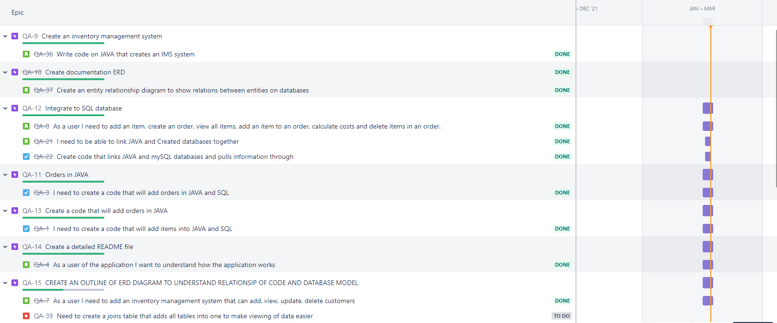
Jira – project planning
The software engineer used JIRA as a means of project planning and documenting, user and developer related tasks and stories - These were created through sprints, epics and any issues of completed or uncompleted tasks were documented.
The engineer used twelve epics and four sprints to outline project details.

Slide 5
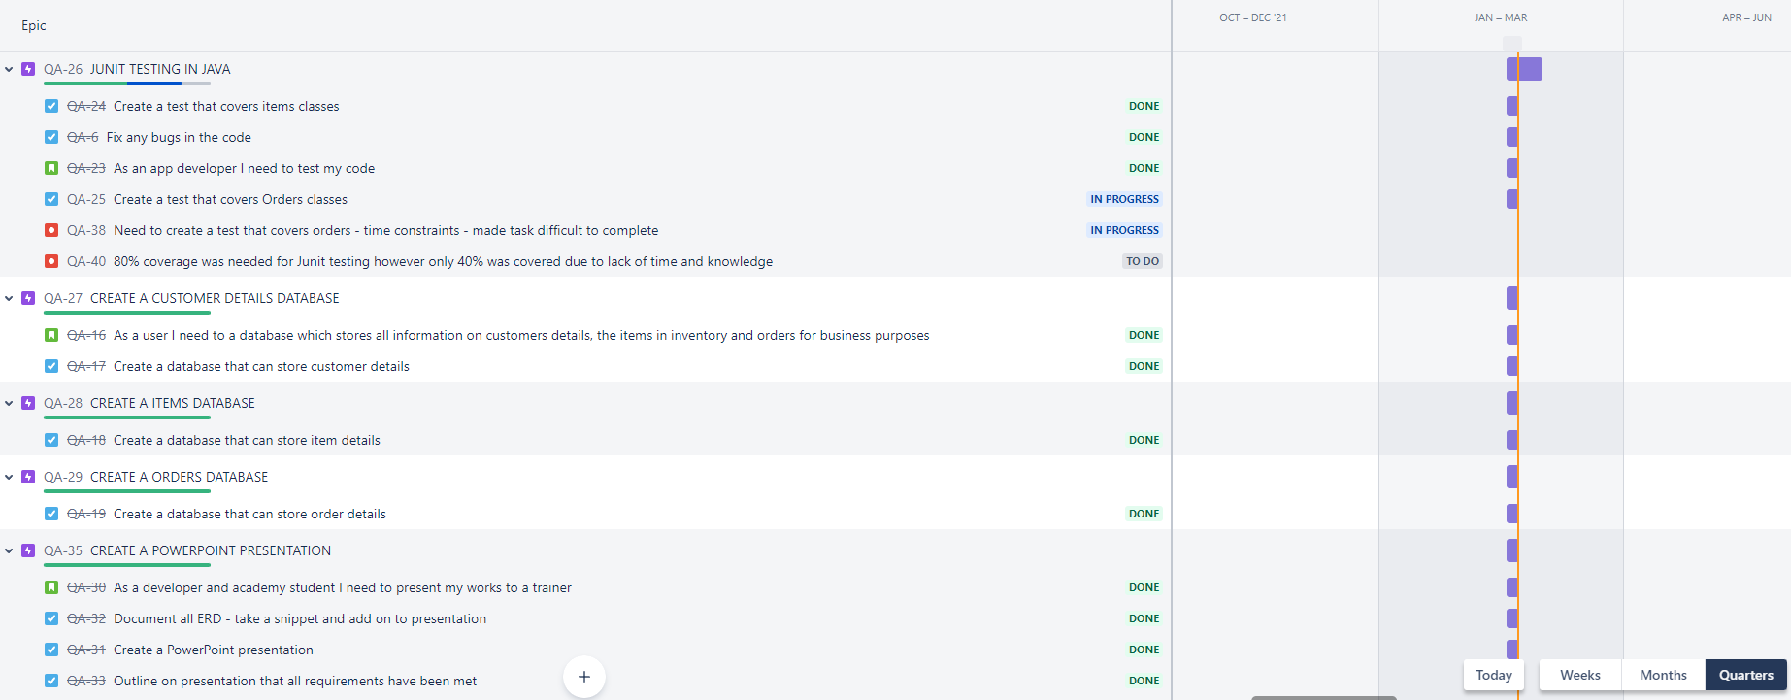
JIRA PROJECT CONTINUED and sprint review
Majority of sprints were completed to meet the requirements of a fully functional application with reference to features needed in the inventory management system.
Any issues which occurred were highlighted in red – these were mainly in the testing stage, where time constraints and knowledge contributed to difficulties in the task
The author was able to navigate the JIRA quite effectively and each sprint lasted a week
A review of what could have been done is to create more user stories on testing and complete the testing on order items however due to time constraints this proved difficult.
An export has been added to the GitHub repo to illustrate full working.

Slide 6
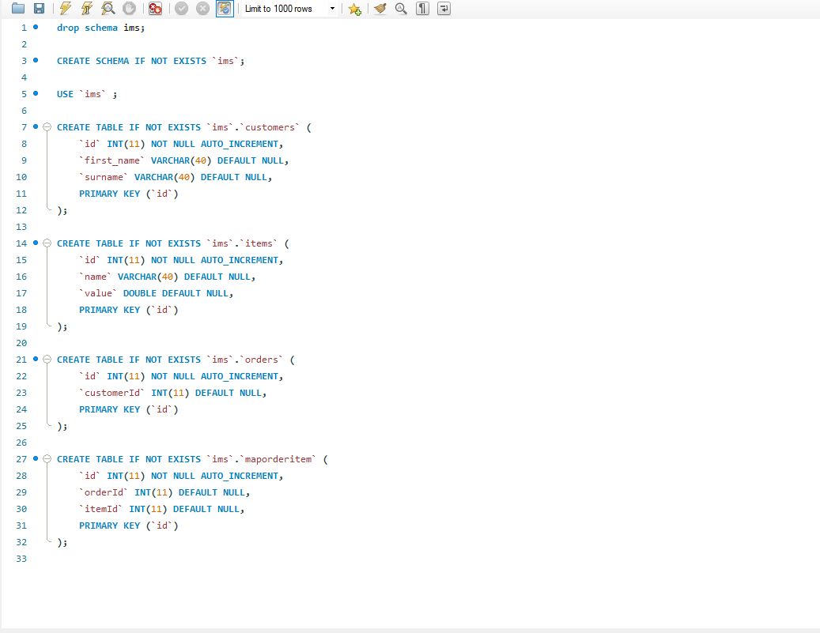
Database creation on mySQL
MySQL was used to create tables to store information inputted by the application users with the following code used.
Table Customers
Table Items
Table Orders
Table maporderitems

Slide 7
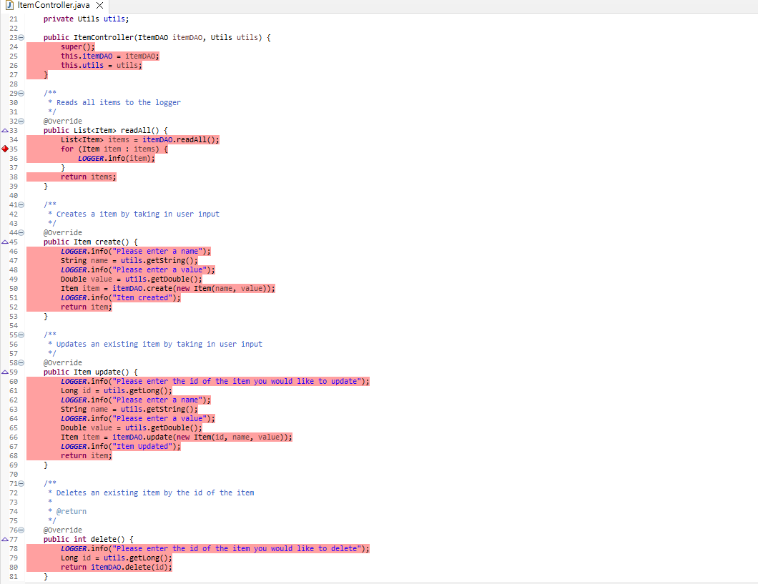
Creation of java code – CONtroller code for items
Eclipse IDE was used to create codes for the application.
The following codes were used to create a controller functionality of JAVA
These functions creates string messages, generated by what the application user inputs.

Slide 8
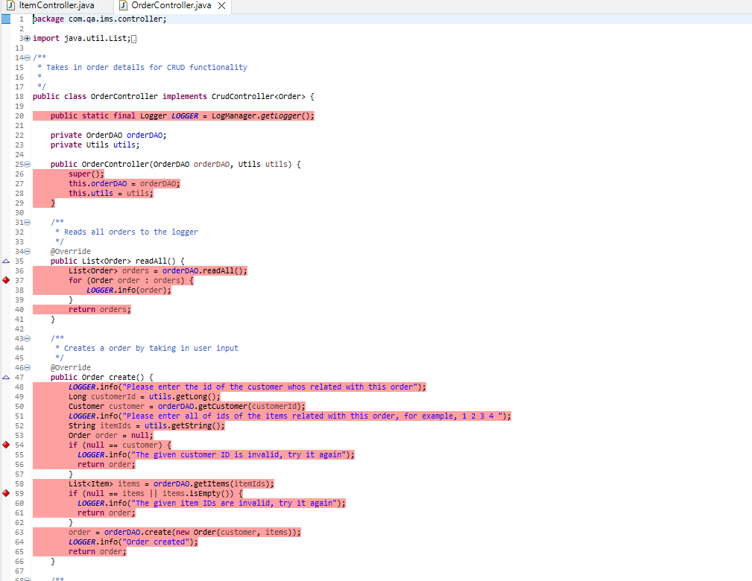
Java controller code for orders
The following codes was created for orders controller.
Super() was used to take call upon parent classes, methods and variables.
More string messages were created to generate user outputs

Slide 9
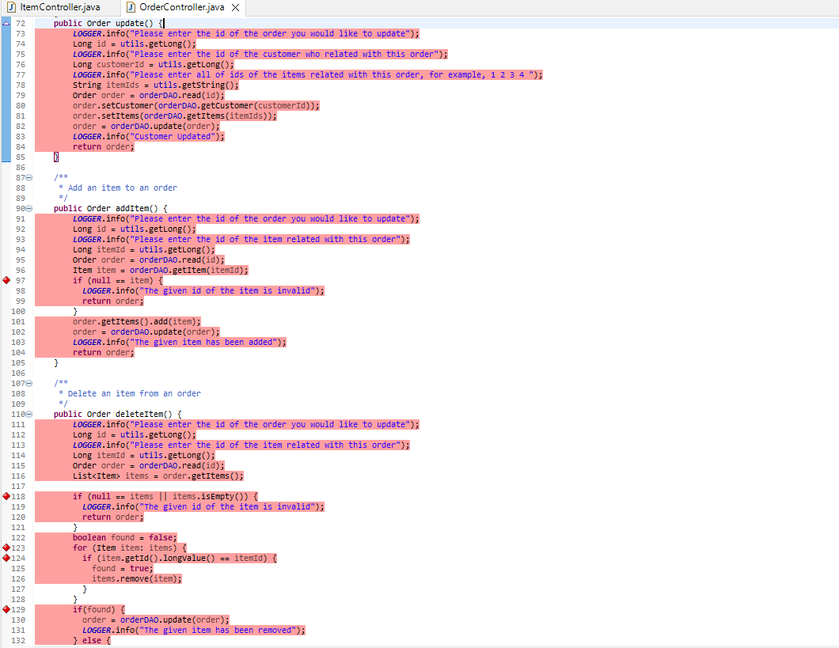
Java controller code for orders - continued
Continued code creation, for adding, deleting items and as well as if or else statements were created to cover requirements of the application specification and a user friendly experience.

Slide 10
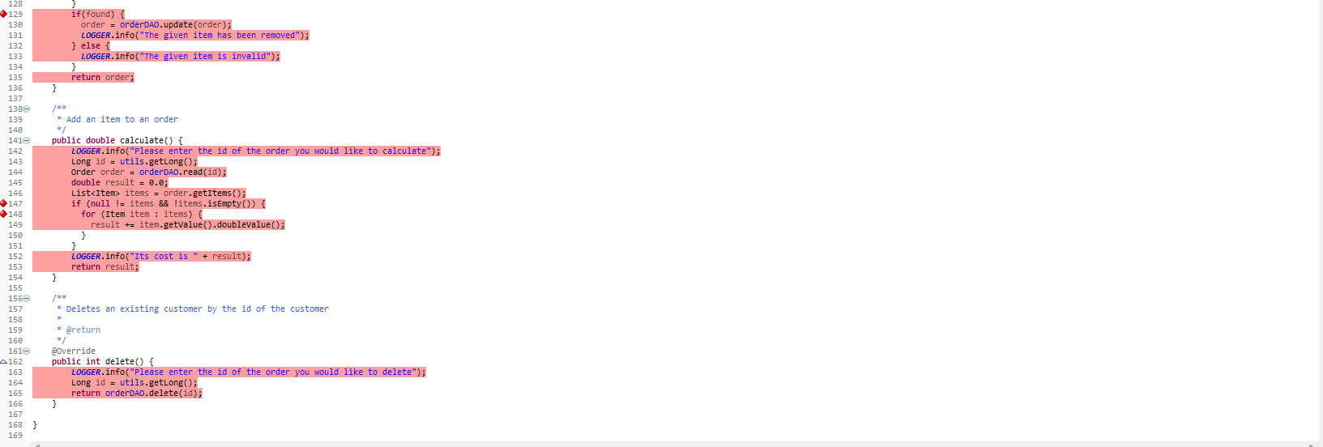
JAVA CONTROLLER CODE for ORDERS continued
A calculator was inputted to calculate the total cost of items and a delete item code.
All strings messages were attached to create a friendly and interactive command line interface.

Slide 11
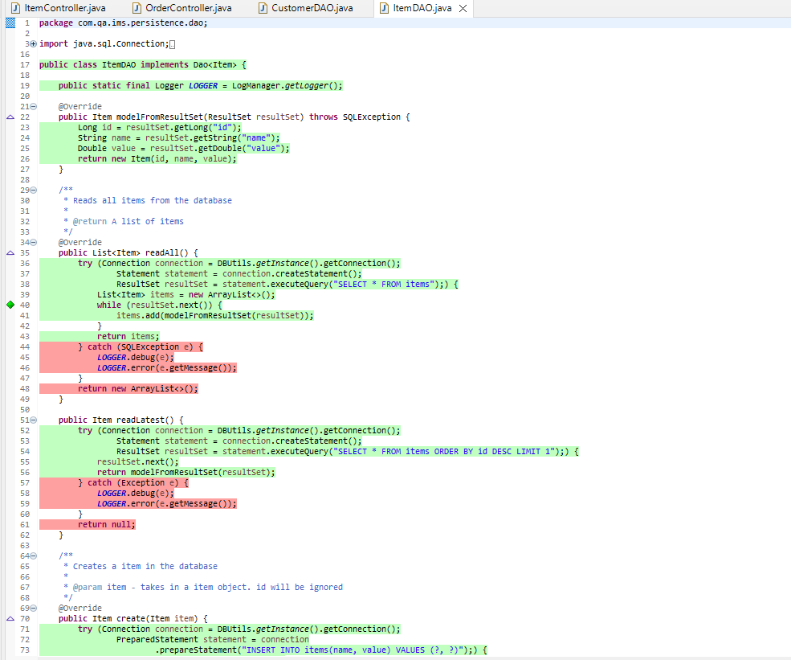
JAVA dao creation for mysql integration – item dao
This part of the presentation will outline the code created for database integration.
Try statements were used to connect java and MySQL.
Arraylist were implemented to data could be added into items.

Slide 12
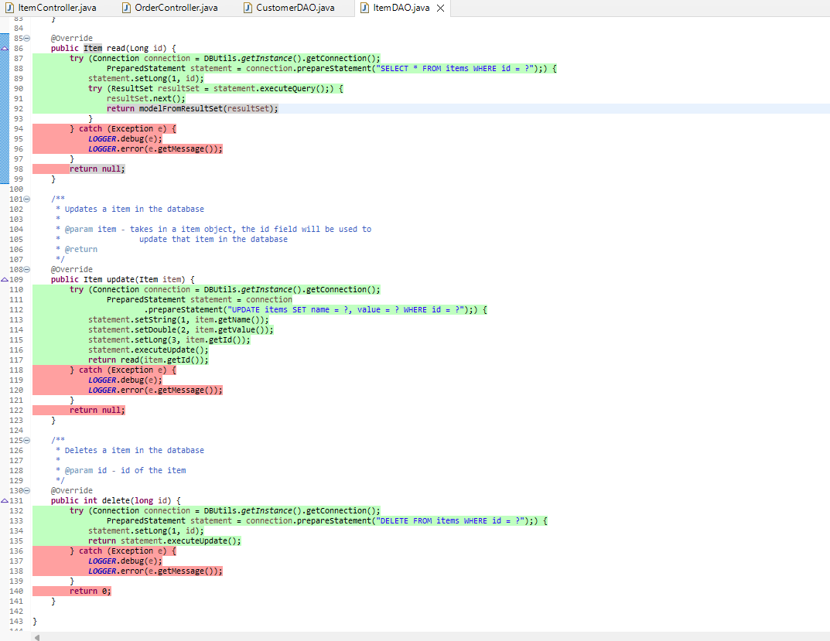
Java dao creation for mysql integrations – iteam dao - continued
Continuation showing code.

Slide 13
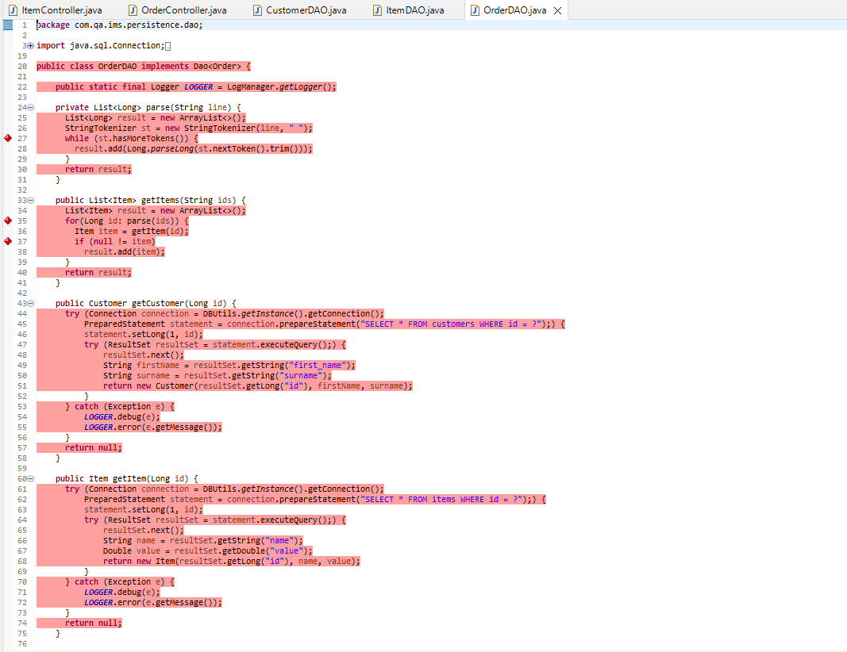
Java dao creation for order dao
This demonstrates the code for order items that was used for order dao and integration.

Slide 14
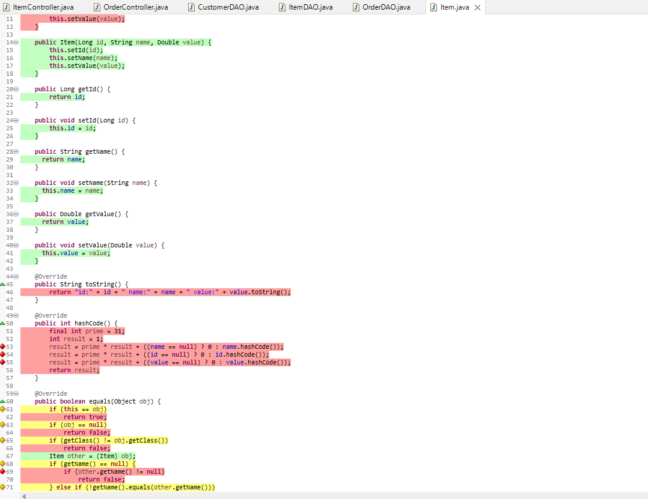
Java persistence domain - item
This outlines the code created for domains.
Public Strings, Booleans and were created to retrieve data inputted from application user.

Slide 15
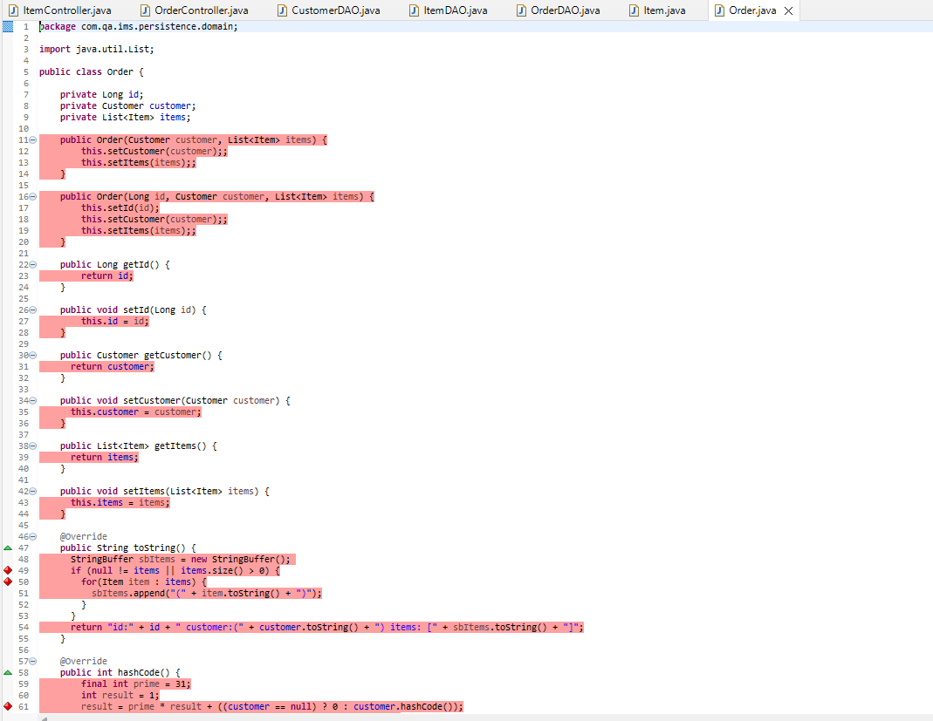
Java persistence domain – order
Demonstration of order codes.

Slide 16
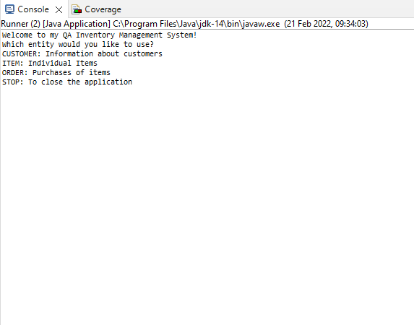
Command line user interface
This shows the instructions on Command Line Interface when application has been executed to run.
The command line prompts the user to select from an entity.
Then will ask for further steps the user may want to do with these enitities.

Slide 17
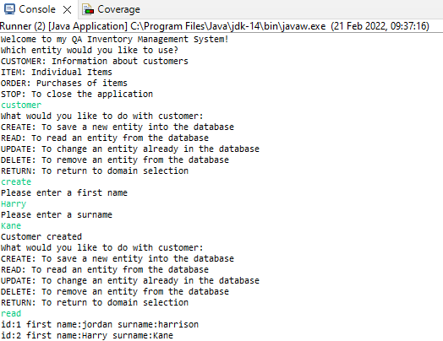
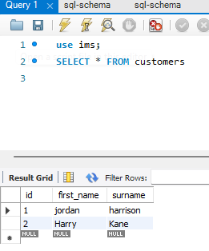
Command line user interface continued
This shows the further running of the application and what the outcomes are.
Moreover, the data has pulled through on to MySQL databases and stored successfully in the correct collums.

Slide 18
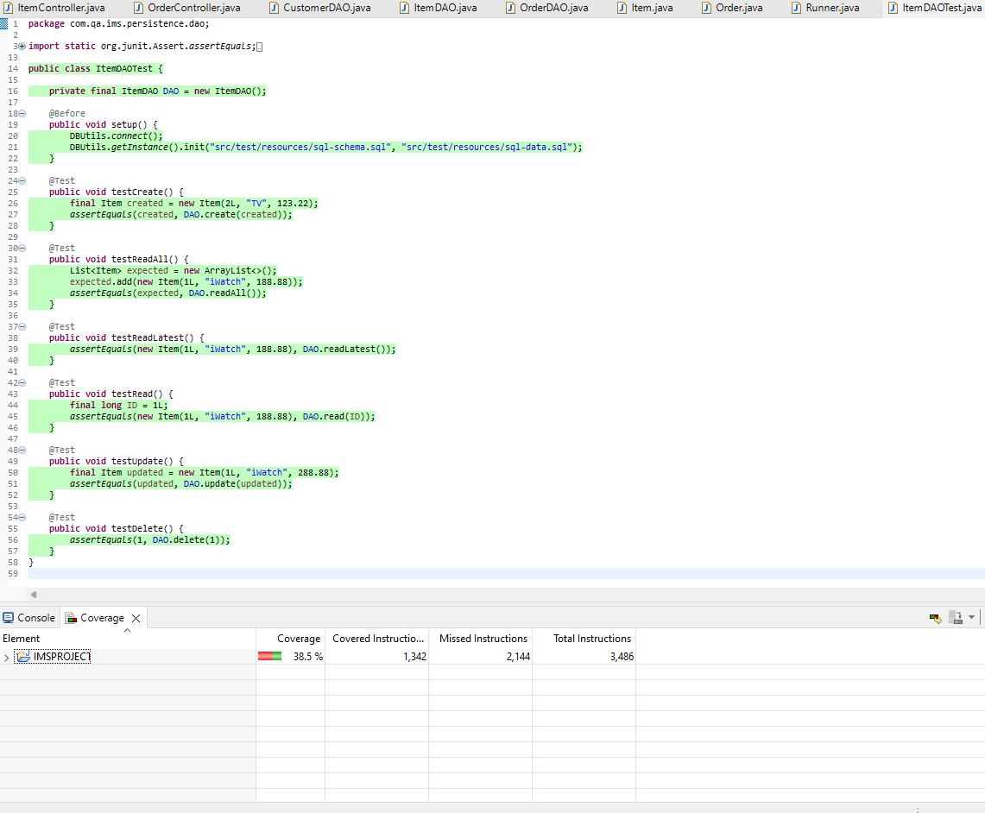
Testing – JUNIT – ITEMS CLASS
The items class was tested, and a total coverage across tests was 38.5%
More tests could have been conducted however, time constraints, and lack of knowledge to implement more tests contributed not reaching an 80% benchmark that the engineer set out.

Slide 19
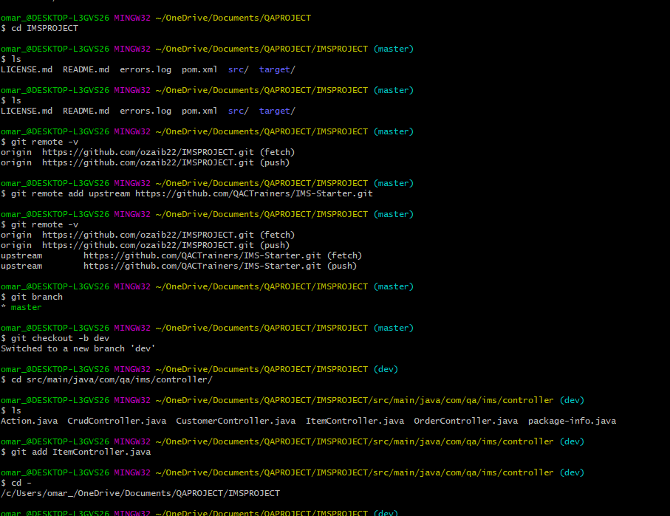
Git CLI Commands to dev branch and version control method
Creation of Dev Branch to add and commit files to online GitHub.

Slide 20
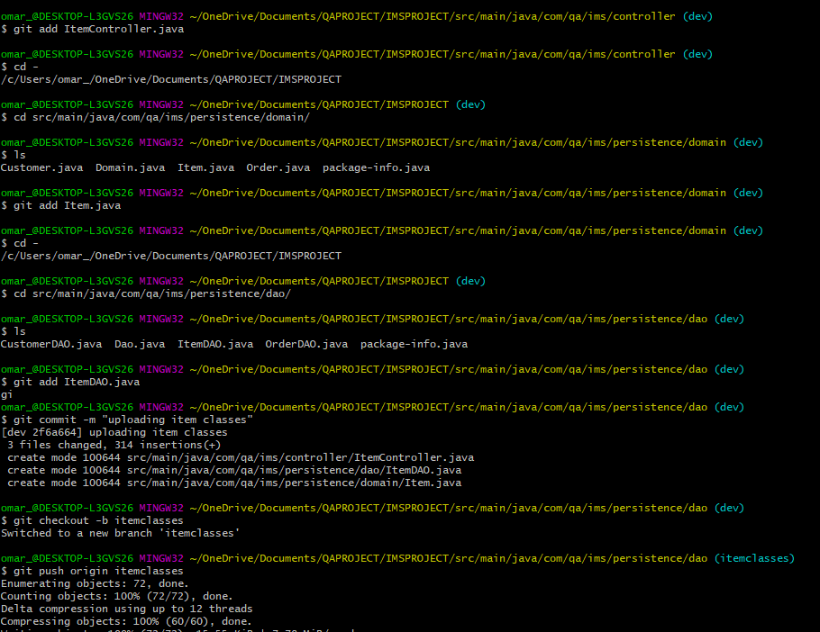
GIT command LINE continued
Creation of items classes on Github

Slide 21
conclusion
To conclude the developer, learnt the following:
Time management
Experience of creating a working application
Use of integration of databases with java code
Future consideration:
Expand on knowledge

